Slide 1
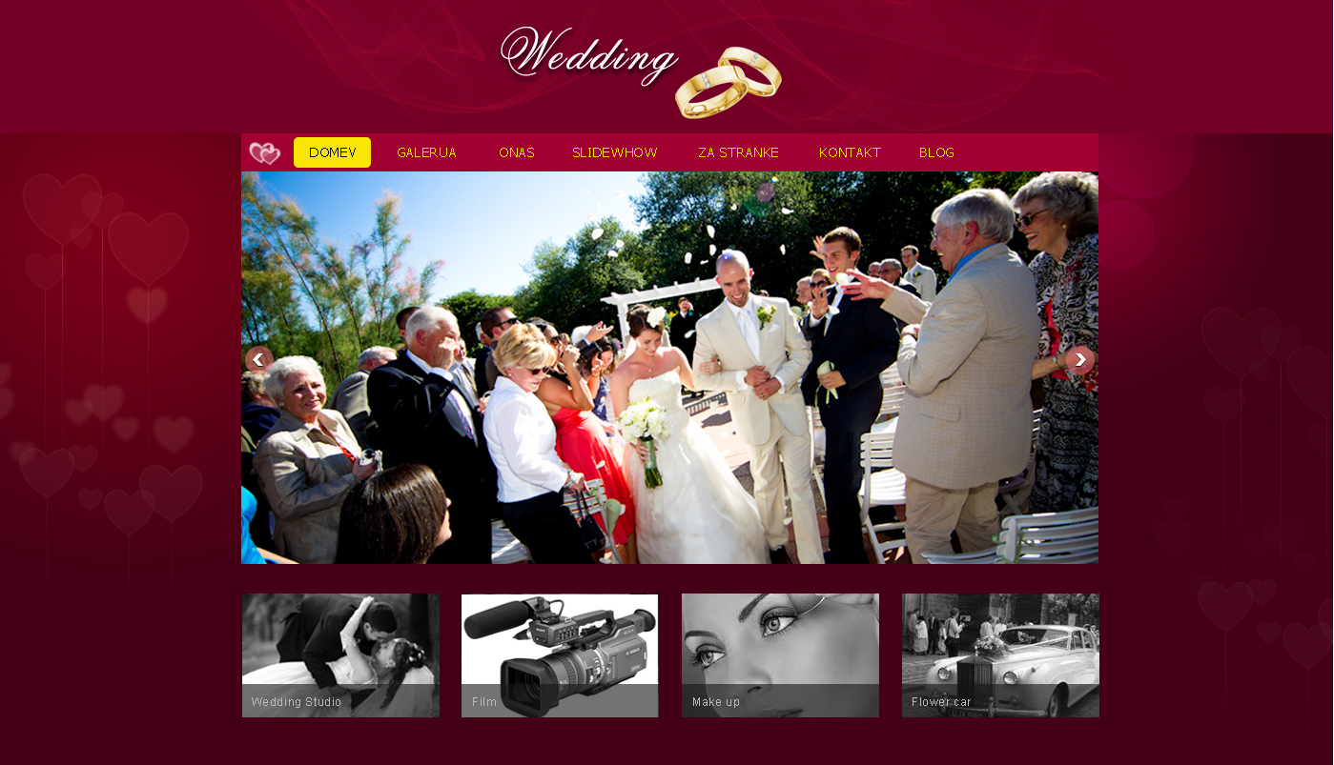
Photographer Functional Specification

Slide 2

Domov
This is the index page of site.
This page includes main part : Sliding Graphic.
Sliding Graphic include two parts: Content Image ( the image in center), and showing images ( list of images in bottom).
When you click each image in bottom then this image will be showed in the content image. For each image was hovered over then it will be painted full color.
We will remove all services text ("make-up studio", "flower car", "the film“). And replace them by all weeding photo.

Slide 3
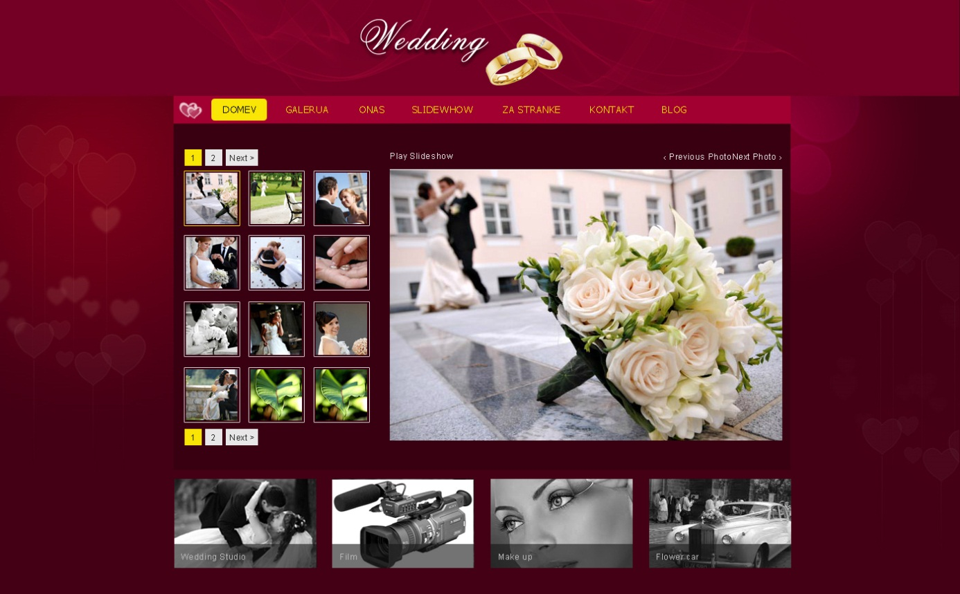
Galerija
This page is Gallery page.
Be Similar this image.

Slide 4
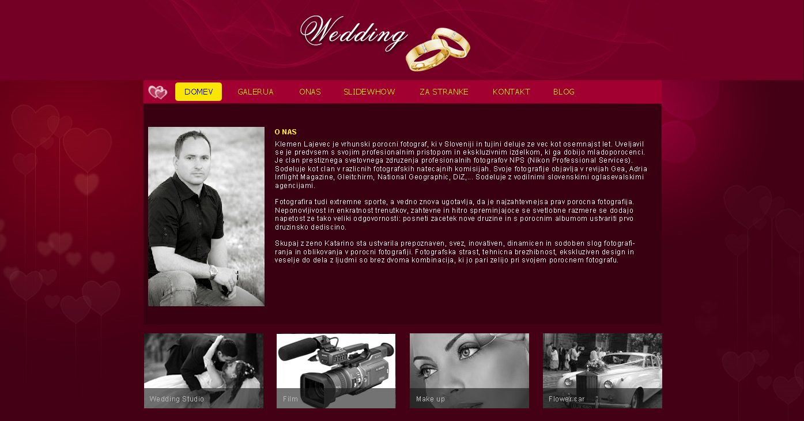
Onas
This is “About Us” page.
Be similar this image.

Slide 5
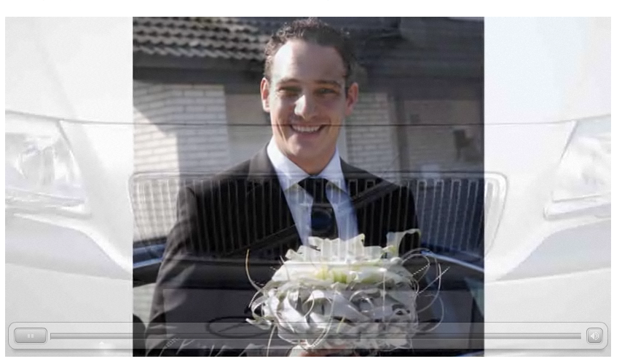
SlideShow
This is the page will be show a video in a center of page similar this image.
Note: this image just show the center part.

Slide 6
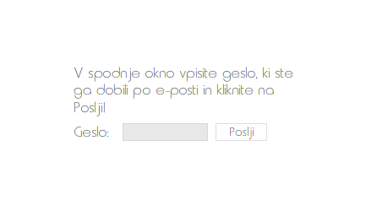
Za stranke
This page talks about customer. We should implement this page later. However, it would be similar this image.
Note: this image just show the center part.

Slide 7
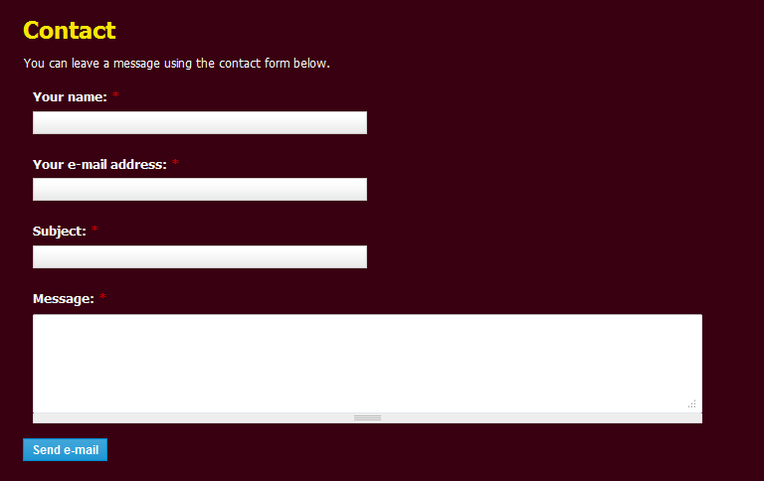
Kontakt
This page is “Contact” page.
All users can put something about their contact after that send email to administrator.

Slide 8
Blog
This item menu will be link to blog of site. The blog would have a layout similar this link:
http://klemenlajevec.si/blog/

